Slide 1
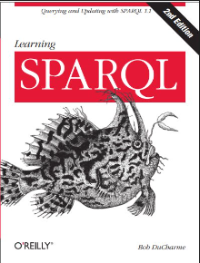
Learning
001
SPARQL
(opening & intro)
Author: Bob DuCharme
Xiaoqi Zhao, GitHub: https://github.com/yasenstar/Learn_SPARQL

Slide 2
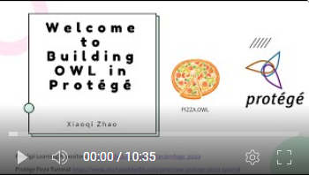
Opening & Intro
About the Book
Learning Notes and Practical Code – GitHub (& Gitee)
https://github.com/yasenstar/Learn_SPARQL
https://gitee.com/yasenstar/Learn_SPARQL
Mindmap – by FreePlane
Video series – to be added to YouTube (and others)
Reference Videos: Ontology Practice – pizza.owl by Protege

Slide 3
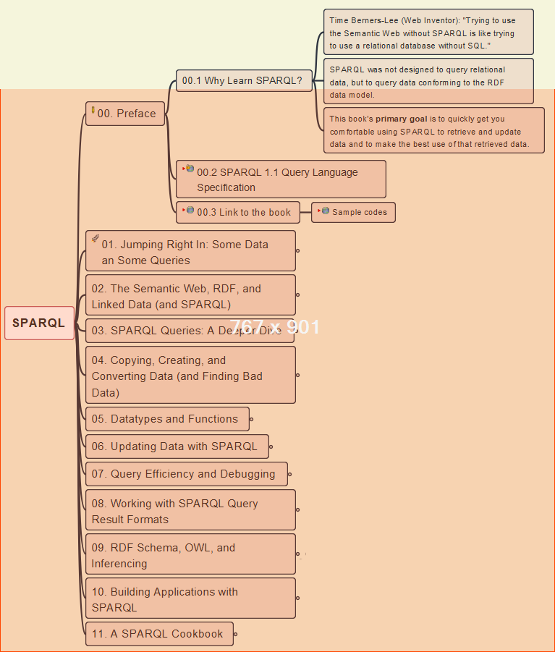
00- Preface
002
Why SPARQL and Resources

Slide 4
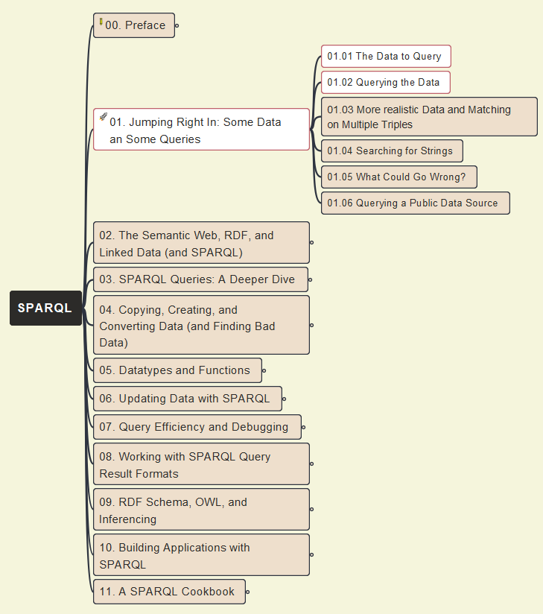
01- Jumping Right In
003
Initial Data Query and Jena (ARQ) Tool

Slide 5
01- Jumping Right In
004
Initial Data Query (cont.)

Slide 6

01- Jumping Right In
005
Initial Data Query (cont.): use Protégé to Query Data

